Slide 1
FOOD ORDERING SYSTEM
1602-20-748-054 m.Tejasri
1602-20-748-056 m.vaishnavi

Slide 2
ABSTRACT
The online food ordering system provides convenience for the customers. This system enhances the speed and standardization of taking the order from the customer. The user’s details are noted electronically. The online food ordering system set up menu online and the customers easily places the order with a simple mouse click. Also with a food menu online you can easily track the orders, maintain customer's database and improve your food delivery service. This system allows the user to select the desired food items from the displayed menu. The payment can be made online or pay-on-delivery system .It maintains a separate account for each user. An id and password is provided for each user. Therefore it provides a more secured ordering.

Slide 3
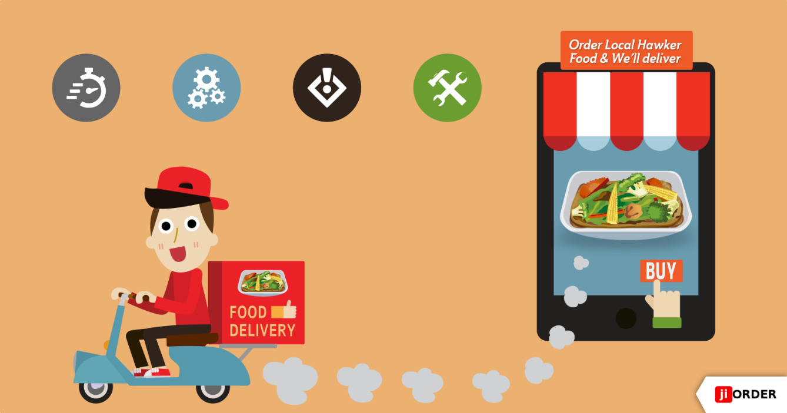
CLASSES
Administer class
Customer class
Manager class

Slide 4
CUSTOMER CLASS
This class provides :
⦁ View product’s list
⦁ Register
⦁ Place orders

Slide 5
MANAGER CLASS
This class provided:
⦁ Create product categories and functionalities,
⦁ Edit / delete product categories and descriptions,
⦁ View and manage orders and sales report

Slide 6
ADMINISTRATOR CLASS
This module is used to create usernames and passwords by admin. Admin can view all the information about the user or delete or edit the all details about the manager and customer.

Slide 7
TECHNOLOGY USED
• Operating System: Windows
• Web Technologies : Html, JavaScript

Slide 8
Log in to account
Select an item from menu
Payment details
Place an order
Get total amount to be paid

Slide 9


